Slide 1
STITCHES SoS Technology Integration Tool Chain for Heterogeneous Electronic Systems
Dr. Evan Fortunato
This Research was developed with funding from the Defense Advanced Research Projects Agency (DARPA)
The views, opinions and/or findings expressed are those of the author and should not be interpreted as representing the official views or policies of the Department of Defense or the U.S. Government

Slide 2
The Goal: Composing Systems That Keep Up With The Times
DoD has long assumed that homogeneous, fixed-configuration weapon systems are the only way to meet their goals of a superior military force
Must last a long time, so requirements are developed for 30+ years out.
Meeting 30 year out requirements with today’s technology is hard
Result is the best design possible with 20-30 year old technology and updates are not efficient with respect to time or cost…
Open Architectures Try to Solve this Problem
Requires enormous effort to reach a “global” consensus on the system architecture,
Even then, it is only a “local” version of “global”
Global standards have to work for everyone, so aren’t optimized for your application
Result is heterogeneous components in a homogeneous architecture – which doesn’t work because the architecture needs to evolve with the technology
Attempts to build flexibility into the architecture (to support heterogeneity) just result in overly complex infrastructures that still don’t anticipate the new technologies
What if Global Interoperability Didn’t Require a Common Interface at ALL?

Slide 3
Understanding the Trade between Local and Global Message Standards…
Local Message Standards
Flexible – You Can Add New Messages Easily
Inefficient - Require N² Transforms (all pairs) for Interoperability
Global Open Standards
Efficient – N Transforms to/from the Global Standard
Not Flexible – Can’t change without tremendous effort
Incremental Standards (STITCHES)
Efficient – ~N Transforms for Interoperability
Flexible – You Can Add New Messages Easily
M2
M#
= Message #
M1
M3
Transform M2 <- M1:
M2 = T21(M1)
Transform M5 <- M1:
M5 = T51(M1)
M5
M4
M2
Transform M2 <- M1:
M2 = T2G(TG1(M1))
Transform M5 <- M1:
M5 = T5G(TG1(M1))
M1
M3
G
M5
M4
M2
Transform M2 <- M1:
M2 = T21(M1))
Transform M5 <- M1:
M5 = T54(T43(T32(T21(M1))))
M1
M3
M5
M4

Slide 4
Key Innovation: Field and Transform Graph (FTG)
Fields are Nodes in the Graph and Contain:
A set of subfields (which are defined by other nodes in the graph)
A set of properties (mathematically precise specification of node properties)
Note: All node information is defined locally, no coordination required!
Nodes are Connected by Links That Define the Transform from Source to Destination Nodes
Each link requires a pair wise human coordination between the source and destination
Transforms Expressed in a Domain Specific Language Built for this Purpose
Graph algorithms determine a composition of transforms (path through the FTG) that produce the destination message given a source message
No Global Coordination Required to Update or Evolve Data in the FTG

Slide 5
STITCHES Uses a Domain Specific Language to Capture the Specification
Why a Domain Specific Language (DSL)?
General Purpose Languages are Hard to Read, Write and Formally Analyze
Standard System Engineering Tools Are Limited
DSL Provides a Narrow Language That is Tailored To This Problem
Assign is the Key STITCHES Capability to Allow Efficient Use of the FTG
Assign designates that two instances represent the same thing in the real world
STITCHES then finds a path through the FTG to convert between the fields
Result is that even if the messages don’t match, many of their subfields will
Sensor Output Message: Sensor.Out
Tracker Input Message: Tracker.In
Time:Sensor.Time
Dets:Sensor.Detection[ ]
DwellTime:Tracker.Time
Contacts: Tracker.Detection[ ]
XForm
XForm(in:Sensor.Out):Tracker.In {
DwellTime = Assign(In.Time);
Contacts = Assign(in.Dets);
}
XForm(in:Sensor.Out):Tracker.In {
DwellTime = In.Time-18;
Contacts = in.Dets*180/3.14159;
}
Resolve

Slide 6
What Does STITCHES Produce?
Subsystem Core
Developed by Subsystem Engineers
Subsystem Interface, Developed by SS Engineer with STITCHES Autogenerated Libraries. Developed once per Core Version to Work for all SoS Configurations
Interface
Generated Glue Code
Autogenerated by STITCHES; Tailored to Each SS and SoS Configuration
Platform 1
Platform 2
Radar Core
Tracker Core
Comms Box
Comms Box
Display Core
Interface
Interface
Interface
Interface
Interface
Shim
Shim
Shim
Shim
Shim
Shim
Transform
EM
Transform
EM
Serialize
EM
Serialize
Deserialize
Serialize
Deserialize
MAC
Deserialize
MAC
MAC
MAC
MAC
Transport
MAC
Transport
Transport
Transport
Transport
Transport
Local Bus Network 1
Local Bus Network 2
MAC: Message Authentication Code
EM: Execution Monitor

Slide 7
STITCHES is Focused on Implementing a Scalable Approach to Building SoS Capabilities
Design Space Exploration
Process FTG to Construct Transformation Chains
Specify Interface Stack by forming & solving optimization problems
Compiler
Construct Interface Stack Structure
Optimize Transforms for this Instance of the Interface
Provide Cyber Security through whitelist property enforcement
Generate C++/Java Code & Compile into binaries
SoS Specification
Community Specifications
(Distributed)
STITCHES
Automated Design Space Exploration
Field & Transform Graph
Subsystem Specs
SoS Configurations
Compile Interfaces
Base Subsystems
Instantiated Subsystems
Result: High Performance Interfaces Optimized For Each Application

Slide 8
Evolution of the Architecture: Backwards Compatibility
We Started with a Sensor_Out and a Tracker_In Message
Sensor.Out
Tracker.In
Time:Sensor.Time
Dets:Sensor.Detection[ ]
DwellTime:Tracker.Time
Contacts:Tracker.Detection[ ]
Next Add a Sensor_Out_With_Sig and connect it to the Sensor_Out
Sensor.Out_With_Sig
Sensor Output Message: Sensor.Out
Time:Sensor.Time
SigDets:Sensor.SigDet[ ]
Time:Sensor.Time
Dets:Sensor.Detection[ ]
Sensor.SigDet
Sensor.Detection
Lat:Sensor.Lat
Lon:Sensor.Lon
Sig:Sensor.Sig
Lat:Sensor.Lat
Lon:Sensor.Lon
New Sensor with Signatures Can Now Interoperate with the Tracker
But Tracker Doesn’t Use the Signature Information

Slide 9
Evolution of the Architecture: Forwards Compatibility
Now Let’s Add in an Upgraded Tracker (that can use the Signatures)
Sensor.Out_With_Sig
Tracker.In_With_Sig
Time:Sensor.Time
SigDets:Sensor.SigDet[ ]
DwellTime:Tracker.Time
Contacts: Tracker.SigDet [ ]
Sensor.SigDet
Tracker.SigDet
Lat:Sensor.Lat
Lon:Sensor.Lon
Sig:Sensor.Sig
Lat:Tracker.Lat
Lon:Tracker.Lon
Sig:Tracker.Sig
New Tracker Can Now Use the Full Data from the New Sensor (Including Signatures)
Updated FTG Supports the Old, New and Mixed Architectures
Sensor.Out
Tracker.In
Sensor.Out_With_Sig
Tracker.In_With_Sig

Slide 10
Handling Packed Representations
Many real systems mix their interface definition with their implementation
Result is a serialized (Packed) form of the interface that can represent multiple different interface messages (e.g., STANAG 4607) with descriptor words for run time resolution
Packed messages are often used for run-time efficiency - they tend to be the big / high rate messages in the system. So don’t want to unpack if not necessary
Mirrored Unpacked Nodes Provide an Effective and Efficiency Solution
Create a Second Unpacked Node that Contains a Structured Version of the Interface
Create Transforms between the Unpacked and Packed Nodes
Interact with other Interfaces via their Unpacked Representations
Auto-generate the Desired (high performance) Packed-to-Packed Transforms
Auto-generated Transform Chain
Packed Msg1
Packed Msg2
Unpacked Msg1
Unpacked Msg2

Slide 11
Optimized Performance: [Packed → Unpacked → Unpacked → Packed] vs. [Packed → Packed]
Connection | PUUP vs PP | Java Implementation |  | C++ Implementation
 |  | Speed Mbps | Latency ms | Speed Mbps | Latency ms
R1 -> T1 (No Transform) | PUUP | 2956 | 1.1 | 2818 | 0.7
R1 -> T1 (No Transform) | PP | 2956 | 1.1 | 2818 | 0.7
R1 -> T2 (Only Change Time) | PUUP | 2783 | 1.2 | 2803 | 0.8
R1 -> T2 (Only Change Time) | PP | 2783 | 1.2 | 2743 | 0.8
R1 -> T3 (Switch Order Lat, Lon) | PUUP | 1789 | 1.4 | 1773 | 0.9
R1 -> T3 (Switch Order Lat, Lon) | PP | 1804 | 1.4 | 1747 | 0.9
R1 -> T4 (Change All Fields) | PUUP | 1245 | 1.6 | 1555 | 0.9
R1 -> T4 (Change All Fields) | PP | 1228 | 1.6 | 1643 | 1.0
MAC and Execution Monitors are Disabled for these Performance Runs
All interactions via localhost, so no network latencies are involved
Data Gathered on a Standard (~4 Year Old) Quad Core Workstation

Slide 12
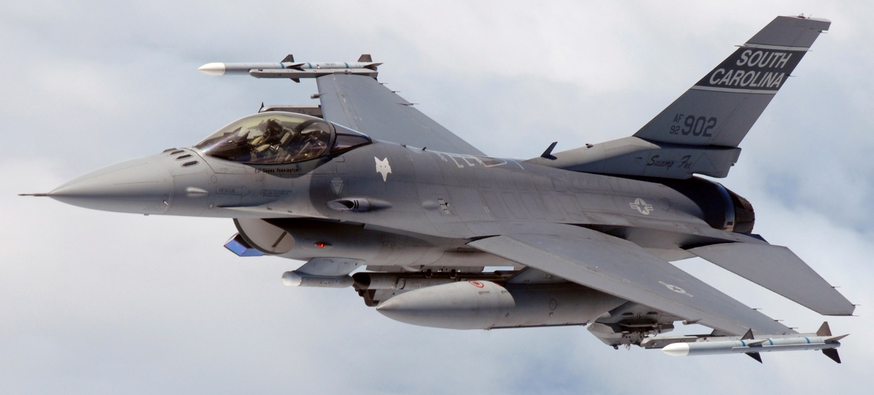
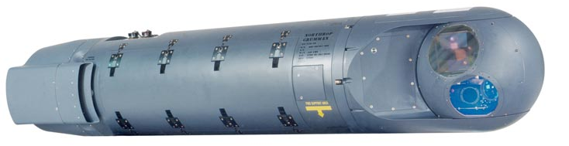
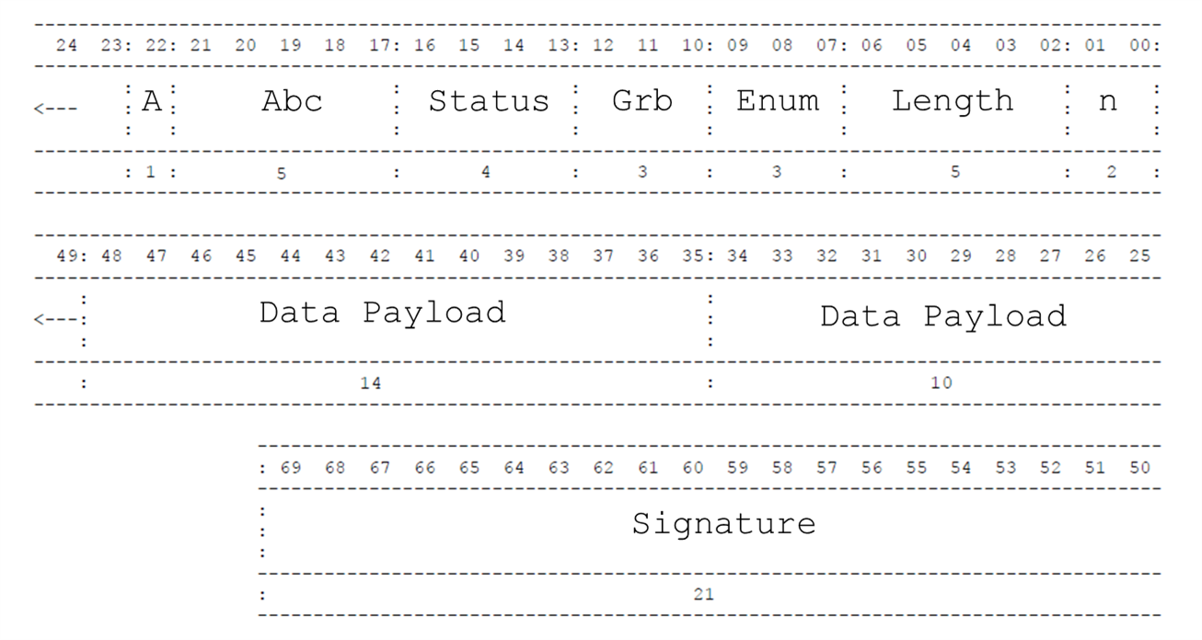
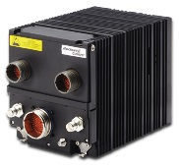
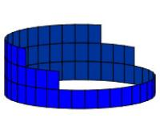
Interoperability via Legacy Comms, What if desired messages aren’t supported?
Display Tracks
Pod Tracks
?
?
Legacy Comm Message
Legacy Comm Message
Legacy Comm Message

Slide 13
Auto-generate Transcoder to “Encode” Messages into Legacy Comms Messages
~20 hours to Study Spec and Capture Each Message in FTG (1 time Cost)
Display Tracks
Transform
Pod Tracks
Legacy Msg (600 Bits)
2 Minutes on Laptop
Pod Tracks
Serialize
Transcoder Generator
Deserialize
Transcode
Transcoder
Transcode
Legacy Comm Messages
Free Bits (503)
Legacy Comm Messages
Fixed Bits (97)
Manually Defined
Automatically Created
Capability Demonstrated in Live Flight in January 2018 with Example Legacy Comm’s System

Slide 14
STITCHES Allows a New Approach to System Integration
FTG Efficiently Captures Information Required for Interoperability
No Global Coordination, Just local and Pairwise Interactions
Ontology defined via transformation, not semantics
STITCHES Allows for the Rapid Instantiation of SoS Capabilities
Compile new SoS integrations in minutes, not months
Each instance is tailored (optimized) for the needs of that SoS
STITCHES Is Available to Anyone in DoD As Open Source Toolchain
Register for account (with a DoD Gov/contractor email) at www.stitches.tech
Full source, install packages, training packages, pre-built VM, user forums, etc.
Targeting Public, Open Source Release of STITCHES (not FTG which contains DoD Data)
STITCHES Is Very Mature for a DARPA Project
Dozen Major Releases with large user base.
Training sessions since 2015 (300+ people)
Used at 8+ major events, including multiple flight events

