Slide 1
Symmetries in Software
Evan Fortunato
HCSS 2017
May 10th, 2017
This Research was developed with funding from the Defense Advanced Research Projects Agency (DARPA)
The views, opinions and/or findings expressed are those of the author and should not be interpreted as representing the official views or policies, either expressed or implied, of the Department of Defense or the U.S. Government

Slide 2
Abstraction / Composition is the Computer Science Approach to Managing Complexity
If Abstraction Holds, System Functions Can Be Reasoned Over Compositionally
Allows for scalable engineering, testing and development
Allows for fault tolerant cascades of resilient methods
Allows for predictable development (budget, schedule, etc.)
Interfaces are Simple Compared To & Invariant Over Underlying Implementations
Abstractions practically hold only over a narrow range of environmental conditions – abstraction doesn’t work across a wide range of applications
Abstractions practically hold due to wild overprovisioning of resources – abstraction doesn’t work well in SWAP (Size, Weight and Power) limited cases
More Complex Interfaces Allows for More Resilient Abstractions, but Increases the Complexity of Composition
Deep Specification allows for formal analysis
Exposing more internal implementation details allows for more optimization
Exposing more environmental conditions allows for more robustness
Is There Another Approach for Achieving Resilient & Efficient Compositionality?

Slide 3
We Will Heavily Borrow from the Concept of Symmetries in Physics
What Do We Mean by Symmetry?
Physicists define a symmetry of an action by its conserved quantity
An action has a symmetry if there is a property of a state which remains unchanged by the action
Lots of well known symmetries (mirror, space, time, energy, momentum, etc.)
Direct relationships to mathematical groups and equivalence classes
Noether’s Theorem From Physics Provides a Useful Roadmap
Simple Version: Symmetries Imply Conserved Quantities, Conserved Quantities Imply Symmetries
Use: You don’t need to understand all the details – if you can identify a symmetry, then you can deduce a lot from the conserved quantities, even if you don’t know the underlying equations of motion
The Next Few Slides Walk Through Some Examples To Get Everyone On The Same Page and Show the Relationship between Abstraction and Symmetry
Conclusion: Abstraction is a form of Symmetry

Slide 4
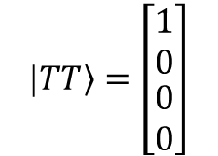
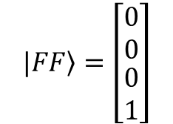
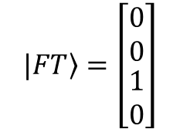
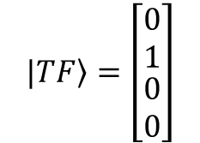
How a Physicist “Sees” Bits (and Qubits)
$$\begin{matrix}|\left.T\right\rangle =\left[\begin{matrix}1 \\ 0\end{matrix}\right] & |\left.F\right\rangle =\left[\begin{matrix}0 \\ 1\end{matrix}\right]\end{matrix}$$
A Single Two State System:
A Set of Bits is Defined by the Kronecker Product of their States:
$$|\left.F\right\rangle ⨂|\left.F\right\rangle ≝|\left.FF\right\rangle =\left[\begin{matrix}0 \\ 1\end{matrix}\right]⨂\left[\begin{matrix}0 \\ 1\end{matrix}\right]=\left[\begin{matrix}0∙\left[\begin{matrix}0 \\ 1\end{matrix}\right] \\ 1∙\left[\begin{matrix}0 \\ 1\end{matrix}\right]\end{matrix}\right]=\left[\begin{matrix}\begin{matrix}0 \\ 0\end{matrix} \\ \begin{matrix}0 \\ 1\end{matrix}\end{matrix}\right]$$
$$|\left.FF\right\rangle =\left[\begin{matrix}\begin{matrix}0 \\ 0\end{matrix} \\ \begin{matrix}0 \\ 1\end{matrix}\end{matrix}\right]$$
$$|\left.FT\right\rangle =\left[\begin{matrix}\begin{matrix}0 \\ 0\end{matrix} \\ \begin{matrix}1 \\ 0\end{matrix}\end{matrix}\right]$$
$$|\left.TF\right\rangle =\left[\begin{matrix}\begin{matrix}0 \\ 1\end{matrix} \\ \begin{matrix}0 \\ 0\end{matrix}\end{matrix}\right]$$
$$|\left.TT\right\rangle =\left[\begin{matrix}\begin{matrix}1 \\ 0\end{matrix} \\ \begin{matrix}0 \\ 0\end{matrix}\end{matrix}\right]$$

Slide 5
How a Physicist “Sees” Operators on Bits
Consider Some Basic 1 Bit Operations:
Identity:
$$\begin{matrix}\text{=}\left[\begin{matrix}1 & 0 \\ 0 & 1\end{matrix}\right] & I|\left.T\right\rangle =|\left.T\right\rangle & I|\left.F\right\rangle =|\left.F\right\rangle \end{matrix}$$
SelectTrue:
$$\text{S}\text{T}\text{=}\left[\begin{matrix}1 & 0 \\ 0 & 0\end{matrix}\right]$$
Not:
$$\begin{matrix}\text{X}\text{=}\left[\begin{matrix}0 & 1 \\ 1 & 0\end{matrix}\right] & X|\left.T\right\rangle =|\left.F\right\rangle & X|\left.F\right\rangle =|\left.T\right\rangle \end{matrix}$$
$$\text{S}\text{F}\text{=}\left[\begin{matrix}0 & 0 \\ 0 & 1\end{matrix}\right]$$
SelectFalse:
Consider a Two Bit Conditional Not Operator:
if bit1 == true
bit2 = not(bit2)
else
bit2 = bit2
$$C_{1}^{T}{Not}_{2}= {\text{S}\text{T}}_{1} ⨂{ X}_{2} +{ \text{S}\text{F}}_{1} ⨂{ \text{Ι}}_{2}$$
$$=\left[\begin{matrix}1 & 0 \\ 0 & 0\end{matrix}\right]⨂\left[\begin{matrix}0 & 1 \\ 1 & 0\end{matrix}\right]\text{+}\left[\begin{matrix}0 & 0 \\ 0 & 1\end{matrix}\right]⨂\left[\begin{matrix}1 & 0 \\ 0 & 1\end{matrix}\right]$$
$=\left[\begin{matrix}\begin{matrix}0 & 1 \\ 1 & 0\end{matrix} & \begin{matrix}0 & 0 \\ 0 & 0\end{matrix} \\ \begin{matrix}0 & 0 \\ 0 & 0\end{matrix} & \begin{matrix}0 & 0 \\ 0 & 0\end{matrix}\end{matrix}\right]\text{+}\left[\begin{matrix}\begin{matrix}0 & 0 \\ 0 & 0\end{matrix} & \begin{matrix}0 & 0 \\ 0 & 0\end{matrix} \\ \begin{matrix}0 & 0 \\ 0 & 0\end{matrix} & \begin{matrix}1 & 0 \\ 0 & 1\end{matrix}\end{matrix}\right]$=$\left[\begin{matrix}\begin{matrix}0 & 1 \\ 1 & 0\end{matrix} & \begin{matrix}0 & 0 \\ 0 & 0\end{matrix} \\ \begin{matrix}0 & 0 \\ 0 & 0\end{matrix} & \begin{matrix}1 & 0 \\ 0 & 1\end{matrix}\end{matrix}\right]=$
$$\text{X}$$
$$\text{ 0}$$
$$\text{ 0}$$
$$\text{I}$$

Slide 6
Some Simple Symmetries
If the Environment Can Only Apply the $\text{}$ (identity) Operator
The State doesn’t evolve under the action of the environment
All physical bits are conserved – Computation is really easy because we can use our physical bits as our logical bits
Note, This represents a perfect abstraction from the environment
If the Environment Can Apply X (Not) Operator, but Only Rarely
Symmetry is broken, but only weakly (because error event is rare). The State will pick up errors at a slow rate
Computation is harder now – Can’t use the physical bits as our logical bits
Can We Restore the Symmetry Dynamically?
Yes, via Error Correction
With Error Correction, the abstraction is re-established as the effect of the environment is shifted to bits that we don’t see…

Slide 7
Normal View of Error Correction – Change the State at Each Step
Consider the Action of Simple 3 Bit Hamming Code (Triply Redundant Coding with Majority Vote)
Starting State: 1 Bit of Data and 2 Auxiliary Bits (both initialized to Zero to Start)
True: $|\left.1\right\rangle ⨂|\left.00\right\rangle$
False: $|\left.0\right\rangle ⨂|\left.00\right\rangle$
Encoder:${ C}_{1}^{T}{Not}_{2}{Not}_{3}=$ $S_{1}^{T}⨂X_{2}⨂X_{3}+S_{1}^{F}⨂{\text{Ι}}_{2}⨂{\text{Ι}}_{3}$
Environmental Noise: Flip at most 1 Bit
$\text{}⨂\text{Ι}⨂\text{Ι}$ : Flip No Bits
$\text{X}⨂\text{Ι}⨂\text{Ι}$ : Flip First Bit
$\text{}⨂\text{X}⨂\text{Ι}$: Flip Second Bit
$\text{}⨂\text{Ι}⨂\text{X}$ : Flip Third Bit
Decoder: $\left({{Not}_{1}C}_{2}^{T}{ C}_{3}^{T}\right)∙\left({ C}_{1}^{T}{Not}_{2}{Not}_{3}\right)$ (note, right most operation applies first)

Slide 8
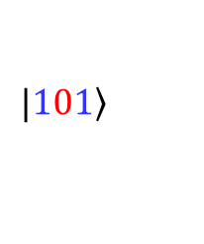
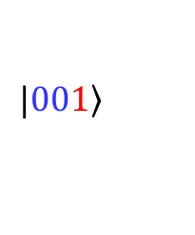
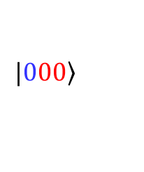
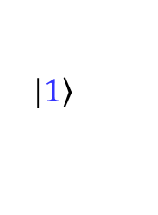
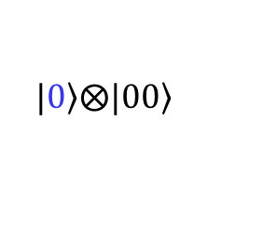
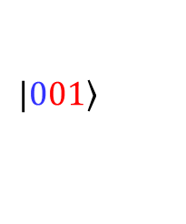
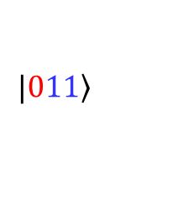
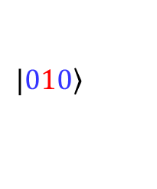
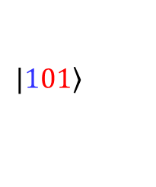
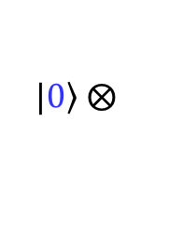
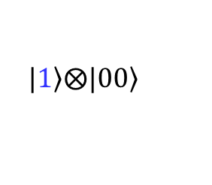
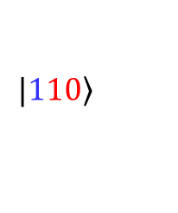
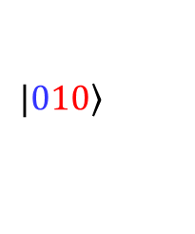
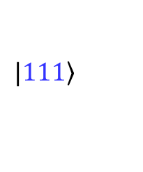
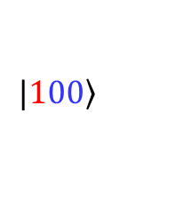
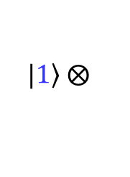
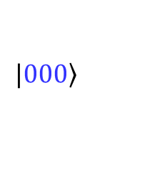
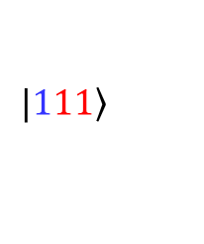
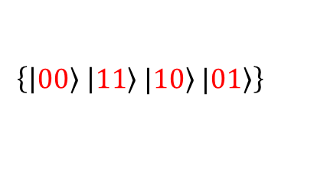
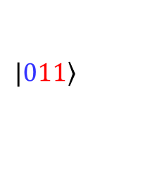
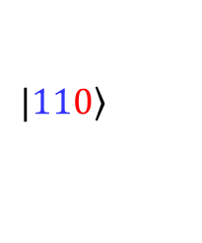
Explicitly Running Through the Steps…
True
False
Starting State (Data)
$$|\left.1\right\rangle$$
$$|\left.0\right\rangle$$
Add 2 Auxiliary Bits
$$|\left.1\right\rangle ⨂|\left.00\right\rangle$$
$$|\left.0\right\rangle ⨂|\left.00\right\rangle$$
Encode (Copy Code)
$$|\left.111\right\rangle$$
$$|\left.000\right\rangle$$
Environmental Noise (Bit Flip)
$$|\left.111\right\rangle$$
$$|\left.011\right\rangle$$
$$|\left.101\right\rangle$$
$$|\left.110\right\rangle$$
$$|\left.000\right\rangle$$
$$|\left.100\right\rangle$$
$$|\left.010\right\rangle$$
$$|\left.001\right\rangle$$
Decode (Majority Vote)
$$|\left.100\right\rangle$$
$$|\left.111\right\rangle$$
$$|\left.110\right\rangle$$
$$|\left.101\right\rangle$$
$$|\left.000\right\rangle$$
$$|\left.011\right\rangle$$
$$|\left.010\right\rangle$$
$$|\left.001\right\rangle$$
Data $⨂$ Syndrome
$$|\left.1\right\rangle ⨂$$
$$\left\{\left|\left.00\right\rangle \right|\left.11\right\rangle |\left.10\right\rangle |\left.01\right\rangle \right\}$$
$|\left.0\right\rangle$ $⨂$
$$\left\{\left|\left.00\right\rangle \right|\left.11\right\rangle |\left.10\right\rangle |\left.01\right\rangle \right\}$$
Our Data Is Preserved! …As long as the Noise Doesn’t Get Any Stronger

Slide 9
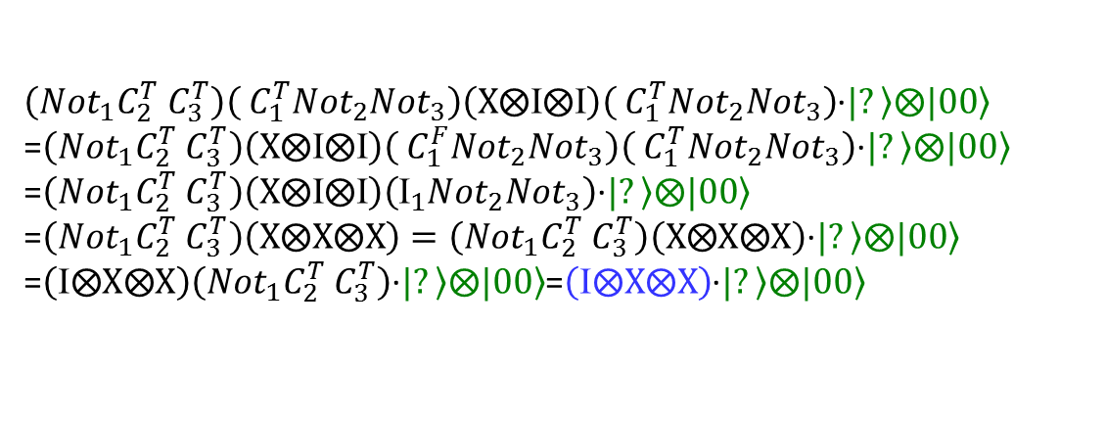
Alternate View of Error Correction – Dynamically Generate a Conditional Symmetry
Expand out & Partially Evaluate Sequence for Each Environmental Actions:
(Decoder ⊗ Environment ⊗ Encoder)∙$|\left.?\right\rangle ⨂|\left.00\right\rangle$
Environment: $\text{}⨂\text{Ι}⨂\text{Ι}$ :
$\left({{Not}_{1}C}_{2}^{T}{ C}_{3}^{T}\right)\left({ C}_{1}^{T}{Not}_{2}{Not}_{3}\right)\left(\text{Ι}⨂\text{Ι}⨂\text{Ι}\right)\left({ C}_{1}^{T}{Not}_{2}{Not}_{3}\right)$∙$|\left.?\right\rangle ⨂|\left.00\right\rangle$
= $\left({{Not}_{1}C}_{2}^{T}{ C}_{3}^{T}\right)\left({ C}_{1}^{T}{Not}_{2}{Not}_{3}\right)\left({ C}_{1}^{T}{Not}_{2}{Not}_{3}\right)\left(\text{Ι}⨂\text{Ι}⨂\text{Ι}\right)\text{∙}|\left.?\right\rangle ⨂|\left.00\right\rangle$
= $\left(\text{}⨂\text{Ι}⨂\text{Ι}\right)\left({{Not}_{1}C}_{2}^{T}{ C}_{3}^{T}\right)\text{∙}|\left.?\right\rangle ⨂|\left.00\right\rangle$=$\left(\text{}⨂\text{Ι}⨂\text{Ι}\right)\text{∙}|\left.?\right\rangle ⨂|\left.00\right\rangle$
Environment: $\text{X}⨂\text{I}⨂\text{I}\text{:}$
$\left({{Not}_{1}C}_{2}^{T}{ C}_{3}^{T}\right)\left({ C}_{1}^{T}{Not}_{2}{Not}_{3}\right)\left(\text{X}⨂\text{Ι}⨂\text{Ι}\right)\left({ C}_{1}^{T}{Not}_{2}{Not}_{3}\right)$∙$|\left.?\right\rangle ⨂|\left.00\right\rangle$
=$\left({{Not}_{1}C}_{2}^{T}{ C}_{3}^{T}\right)\left(\text{X}⨂\text{Ι}⨂\text{Ι}\right)\left({ C}_{1}^{F}{Not}_{2}{Not}_{3}\right)\left({ C}_{1}^{T}{Not}_{2}{Not}_{3}\right)$∙$|\left.?\right\rangle ⨂|\left.00\right\rangle$
=$\left({{Not}_{1}C}_{2}^{T}{ C}_{3}^{T}\right)\left(\text{X}⨂\text{Ι}⨂\text{Ι}\right)\left({\text{Ι}}_{1}{Not}_{2}{Not}_{3}\right)$∙$|\left.?\right\rangle ⨂|\left.00\right\rangle$
=$\left({{Not}_{1}C}_{2}^{T}{ C}_{3}^{T}\right)\left(\text{X}⨂\text{X}⨂\text{X}\right)=\left({{Not}_{1}C}_{2}^{T}{ C}_{3}^{T}\right)\left(\text{X}⨂\text{X}⨂\text{X}\right)$∙$|\left.?\right\rangle ⨂|\left.00\right\rangle$
=$\left(\text{}⨂\text{X}⨂\text{X}\right)\left({{Not}_{1}C}_{2}^{T}{ C}_{3}^{T}\right)$∙$|\left.?\right\rangle ⨂|\left.00\right\rangle$=$\left(\text{}⨂\text{X}⨂\text{X}\right)$∙$|\left.?\right\rangle ⨂|\left.00\right\rangle$
Environment: $\text{I}⨂\text{X}⨂\text{Ι}\text{ :}$
$\left({{Not}_{1}C}_{2}^{T}{ C}_{3}^{T}\right)\left({ C}_{1}^{T}{Not}_{2}{Not}_{3}\right)\left(\text{Ι}⨂\text{X}⨂I\right)\left({ C}_{1}^{T}{Not}_{2}{Not}_{3}\right)$∙$|\left.?\right\rangle ⨂|\left.00\right\rangle$
= $\left({{Not}_{1}C}_{2}^{T}{ C}_{3}^{T}\right)\left({ C}_{1}^{T}{Not}_{2}{Not}_{3}\right)\left({ C}_{1}^{T}{Not}_{2}{Not}_{3}\right)\left(\text{Ι}⨂X⨂I\right)$∙$|\left.?\right\rangle ⨂|\left.00\right\rangle$
= $\left({{Not}_{1}C}_{2}^{T}{ C}_{3}^{T}\right)\left(\text{Ι}⨂\text{X}⨂\text{I}\right)$∙$|\left.?\right\rangle ⨂|\left.00\right\rangle$=$\left(\text{}⨂\text{X}⨂\text{I}\right)\left({{Not}_{1}C}_{2}^{T}{ C}_{3}^{F}\right)$∙$|\left.?\right\rangle ⨂|\left.00\right\rangle$
= $\left(\text{}⨂\text{X}⨂I\right)$∙$|\left.?\right\rangle ⨂|\left.00\right\rangle$
Environment: $\text{I}⨂\text{Ι}⨂\text{X}\text{ :}$
$\left({{Not}_{1}C}_{2}^{T}{ C}_{3}^{T}\right)\left({ C}_{1}^{T}{Not}_{2}{Not}_{3}\right)\left(\text{Ι}⨂\text{X}⨂I\right)\left({ C}_{1}^{T}{Not}_{2}{Not}_{3}\right)$∙$|\left.?\right\rangle ⨂|\left.00\right\rangle$
= $\left(\text{}⨂I⨂X\right)$∙$|\left.?\right\rangle ⨂|\left.00\right\rangle$

Slide 10
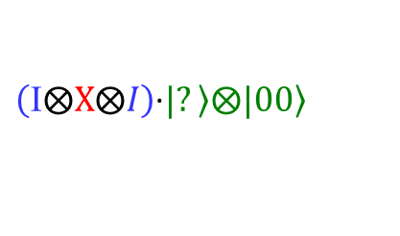
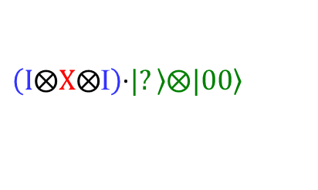
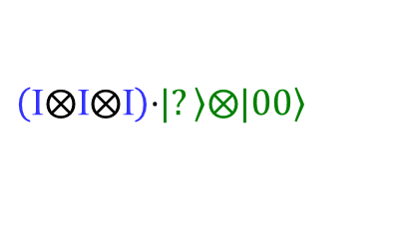
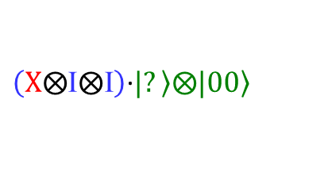
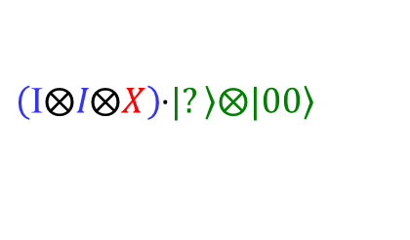
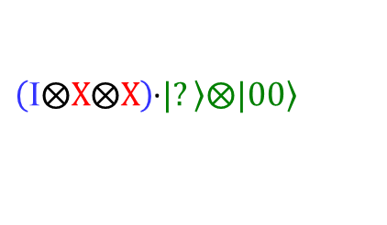
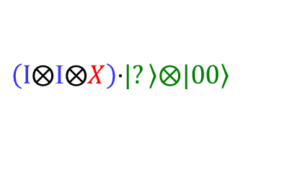
Dynamically Generate a Conditional Symmetry Just the Results
Expand out the Sequence for Each of the Environmental Actions:
(Decoder ⊗ Environment ⊗ Encoder)∙$|\left.?\right\rangle ⨂|\left.00\right\rangle$ vs. Environment∙$|\left.?\right\rangle ⨂|\left.00\right\rangle$
Environment: $\text{}⨂\text{Ι}⨂\text{Ι}$ :
$$\left(\text{}⨂\text{Ι}⨂\text{Ι}\right)\text{∙}|\left.?\right\rangle ⨂|\left.00\right\rangle$$
vs.
$$\left(\text{}⨂\text{Ι}⨂\text{Ι}\right)\text{∙}|\left.?\right\rangle ⨂|\left.00\right\rangle$$
Environment: $\text{X}⨂\text{I}⨂\text{I}\text{:}$
$\left(\text{}⨂\text{X}⨂\text{X}\right)$∙$|\left.?\right\rangle ⨂|\left.00\right\rangle$
vs.
$$\left(\text{X}⨂\text{Ι}⨂\text{Ι}\right)\text{∙}|\left.?\right\rangle ⨂|\left.00\right\rangle$$
Environment: $\text{I}⨂\text{X}⨂\text{Ι}\text{ :}$
$\left(\text{}⨂\text{X}⨂I\right)$∙$|\left.?\right\rangle ⨂|\left.00\right\rangle$
vs.
$$\left(\text{I}⨂\text{X}⨂\text{Ι}\right)\text{∙}|\left.?\right\rangle ⨂|\left.00\right\rangle$$
Environment: $\text{I}⨂\text{Ι}⨂\text{X}\text{ :}$
$\left(\text{}⨂I⨂X\right)$∙$|\left.?\right\rangle ⨂|\left.00\right\rangle$
vs.
$$\left(\text{I}⨂\text{Ι}⨂X\right)\text{∙}|\left.?\right\rangle ⨂|\left.00\right\rangle$$
Result: Generates a Conditional Symmetry
Identity Operator on Bit 1
If Bits 2,3 = False (which they are by definition)

Slide 11
Nice View, But How Does This Really Help?
Consider a Different Environmental Noise
Strong, Frequent Far Field Noise – Flips all of the bits in the channel a large number of times, but always flips all the bits together
Noise Operation is ${\left(\text{X}⨂\text{X}⨂\text{X}⨂\text{X}⨂\text{X}⨂\text{X}⨂\text{X}\text{...}\right)}^{n}$
There is No Possible Finite Distance Error Correcting Code for this Noise
But there is a Symmetry: All Bits are Affected the Same, So the Environmental Noise Is Symmetric to Bit Swaps
Therefore, there must be a conserved quantity / invariant (parity in this case) that is unchanged by the action of the noise
Consider the two bit case:
Starting State: $|\left.00\right\rangle$ -> $|\left.11\right\rangle$ -> $|\left.00\right\rangle$ -> $|\left.11\right\rangle$ -> $|\left.00\right\rangle$ …
Starting State: $|\left.10\right\rangle$ -> $|\left.01\right\rangle$ -> $|\left.10\right\rangle$ -> $|\left.01\right\rangle$ -> $|\left.10\right\rangle$ …
Parity States are Now the Logical True and False States for Computation and are completely robust to all effects of this environmental noise
Result: Looking at the Symmetries Allows Efficient Abstraction from the Details of the Noise – Just Need to Compile Code for the Logical States

Slide 12
Control Theory Is Another Form of Dynamically Generated Symmetry
Consider a Simple Relay System with Noise
System output represents sum of noise and system state
For small disturbances, system operates approximately correctly
Weak symmetry as the system output will naturally drift over time (non-constant)
Can’t Abstract the System from the Environment
Consider a simple feedback control loop
Controller measures error signal (system output – desired value) and then actuates system to bound error
Result: System Output is invariant to noise, therefore a symmetry (identity) is being dynamically generated
Can Now Abstract the System from the Environment
System
Noise Transfer Function
Noise
System Output
+
Desired Value
System Dynamics
System
Noise Transfer Function
Noise
System Output
Control Signal
+
System Dynamics
Error
-
Controller
Desired Value

Slide 13
There is a Relationship between Error Correction and Control Theory
Error Correction (EC) is a Form of Closed Loop Control (CLC)
CLC: Measure the state, actuate the system to reject the noise
EC: Pre-process the state, measure the state, correct the state to reject noise
Control systems are typically stuck in the physical basis, they can’t cheat in a logical basis
System
Noise Transfer Function
Noise
System Output
Control Signal
+
System Dynamics
Error
-
Desired Value
Controller
Error correction uses an extra degree of freedom (pre-processing the state) to construct an equivalent but more controllable system
Controllers of Software (not Controllers Implemented in Software) Can Pre-Process Their State
What does this allow?

Slide 14
Software Symmetries Drives a New Approach
Express the architecture as a set of symmetries that reflect the nature of the problem being solved
Static Symmetries: Traditional APIs
Dynamic Symmetries: OpAmp Analogy (Fixed Gain with Cheap Components Because Resisters are Cheap and Feedback Stabilize Performance)
Compiler generates instances of the solution (consistent with the symmetries) based on what is needed at the moment
Domain Specific Just In Time (DS-JIT) compilation allow this to happen at run time by creating closed loop controller during compilation
New programming construct allow us to automate implementation of the JIT (controller) resulting in
Faster and cheaper development; better run time performance
Improved resiliency to different compositions & environments
All at the same time

Slide 15
Example: Preserving Info on a Comms Line
Consider Two Types of Noise Often Found in a Communication Line
Strong Far Field: Correlated bits flip, arbitrarily often – No Finite Distance Error Code can work but exhibits a swap symmetry
Voltage Drift: If you send many 0s, the line reads 0 when 1 is sent – Must Balance the number of 1s & 0s sent, line balance symmetry
How is it Done today?
Parity Encode the Data to Handle Far Field Noise; Often Implemented via Twisted Pair
8b10b Encode via Extra Bits to Signal Bits Flips to Balance Line (~25% performance hit)
Flip data bits when needed for line balance, use extra two bits to denote data bit flips
Encode
Noise
Decode
0
00
{00, 11}
0
Encode
Noise
Decode
1
10
{10, 01}
1

Slide 16
How Would It Look Via its Symmetries?
Encode
Noise
Decode
The Parity Code on the Previous Page is the Obvious One, but is it the ONLY One?
0
00
{00, 11}
0
Encode
Noise
Decode
1
10
{10, 01}
1
Encode’
Noise
Decode
Nope! Here is another Equally Valid Parity Encoding
0
11
{00, 11}
0
Encode’
Noise
Decode
1
01
{10, 01}
1
Note the difference: Flip the bits, so switch the number of 1s & 0s used to encode the same information
Note that both use the same decoder!
Therefore, switching between these encoders can balance the line with no additional bits!
~20% greater throughput (just need a DS-JIT to manage the switching)
Goal is to have the compiler generate instantiations from the conserved properties of the symmetries (parity, line balance) not just selecting among manually generated instantiations.

Slide 17
A More Complex (and Less Obvious) Example of Symmetries
From the SoSITE Open BAA:
The goal of the System of Systems (SoS) Integration Technology and Experimentation (SoSITE) program is to develop SoS architectures to maintain US air superiority in contested environments, demonstrate rapid integration of mission systems into architectures, and demonstrate the combat effectiveness and robustness of those architectures.
Technical Area 2: Integration Technology Development. This area develops tools to compose distributed architectures and quickly integrate heterogeneous mission systems onto platforms with widely different capabilities.
It Might Not Be Obvious How Symmetries Helps Solve This Problem!
Note, A Detailed Distribution A Presentation Available (If you Want More Details) at http://www.dtic.mil/ndia/2016/systems/18869_Fortunato_SoSITE_STITCHES_Overview_Long_9Sep2016_.pdf

Slide 18
The Goal: Composing Systems That Keep Up With The Times
DoD has long assumed that homogeneous, fixed-configuration weapon systems are the only way to meet their goals of a superior military force
Must last a long time, so requirements are developed for 30+ years out.
Meeting 30 year out requirements with today’s technology is hard
Result is the best design possible with 20-30 year old technology and updates are not efficient with respect to time or cost…
Open Architectures Try to Solve this Problem
Requires enormous effort to reach a “global” consensus on the system architecture,
Even then, it is only a “local” version of “global”
Global standards have to work for everyone, so aren’t optimized for your application
Result is heterogeneous components in a homogeneous architecture – which doesn’t work because the architecture needs to evolve with the technology
What if Global Interoperability Didn’t Require a Common Interface at ALL?
Distribution Statement “A” (Approved for Public Release, Distribution Unlimited)

Slide 19
Understanding the Trade between Local and Global Message Standards…
Local Message Standards
Flexible – You Can Add New Messages Easily
Inefficient - Require N² Transforms (all pairs) for Interoperability
Global Open Standards
Efficient – N Transforms to/from the Global Standard
Not Flexible – Can’t change without tremendous effort
Incremental Standards
Efficient – ~N Transforms for Interoperability
Flexible – You Can Add New Messages Easily
M2
M#
= Message #
M1
M3
Transform M2 <- M1:
M2 = T21(M1)
Transform M5 <- M1:
M5 = T51(M1)
M5
M4
M2
Transform M2 <- M1:
M2 = T2G(TG1(M1))
Transform M5 <- M1:
M5 = T5G(TG1(M1))
M1
M3
G
M5
M4
M2
Transform M2 <- M1:
M2 = T21(M1))
Transform M5 <- M1:
M5 = T54(T43(T32(T21(M1))))
M1
M3
M5
M4
Distribution Statement “A” (Approved for Public Release, Distribution Unlimited)

Slide 20
Key Innovation: Field and Transform Graph (FTG)
Fields are Nodes in the Graph and Contain:
A set of subfields (which are defined by other nodes in the graph)
A set of properties (mathematically precise specification of node properties)
Note: All node information is defined locally, no coordination required!
Nodes are Connected by Links That Define the Transform from Source to Destination Nodes
Each link requires a pair wise human coordination between the source and destination
Transforms Expressed in a Domain Specific Language Built for this Purpose
Graph algorithms determine a composition of transforms (path through the FTG) that produce the destination message given a source message
No Global Coordination Required to Update or Evolve Data in the FTG
Distribution Statement “A” (Approved for Public Release, Distribution Unlimited)

Slide 21
Handling Packed Representations
Many real systems mix their interface definition with their implementation
Result is a serialized (Packed) form of the interface that can represent multiple different interface messages (e.g., STANAG 4607) with descriptor words for run time resolution
Packed messages are often used for run-time efficiency - they tend to be the big / high rate messages in the system. So don’t want to unpack if not necessary
Mirrored Unpacked Nodes Provide an Effective and Efficient Solution
Create a Second Unpacked Node that Contains a Structured Version of the Interface
Create Transforms between the Unpacked and Packed Nodes
Interact with other Interfaces via their Unpacked Representations
Auto-generate the Desired (high performance) Packed-to-Packed Transforms
Auto-generated Transform Chain
Packed Msg1
Packed Msg2
Unpacked Msg1
Unpacked Msg2
Distribution Statement “A” (Approved for Public Release, Distribution Unlimited)

Slide 22
Optimized Performance: [Packed → Unpacked → Unpacked → Packed] vs. [Packed → Packed]
Connection | PUUP vs PP | Java |  | C++
 |  | Speed Mbps | Latency ms | Speed Mbps | Latency ms
R1 -> T1 (No Transform) | PUUP | 3000±35 | 1.1±0.1 | 2889±52 | 0.7±0.1
R1 -> T1 (No Transform) | PP | 3005±18 | 1.0±0.1 | 2897±38 | 0.7±0.1
R1 -> T2 (Only Change Time) | PUUP | 1972±18 | 1.1±0.1 | 2891±38 | 0.7±0.1
R1 -> T2 (Only Change Time) | PP | 1967±22 | 1.2±0.1 | 2889±53 | 0.7±0.1
R1 -> T3 (Switch Order Lat, Lon) | PUUP | 1100±9 | 1.5±0.1 | 1035±32 | 1.1±0.1
R1 -> T3 (Switch Order Lat, Lon) | PP | 1058±9 | 1.6±0.1 | 1042±25 | 1.2±0.1
R1 -> T4 (Change All Fields) | PUUP | 685±5 | 2.0±0.1 | 963±23 | 1.2±0.1
R1 -> T4 (Change All Fields) | PP | 755±7 | 1.9±0.1 | 898±21 | 1.3±0.05
All interactions via localhost, so no network latencies are involved
Data Gathered on a Standard Quad Core Workstation
Distribution Statement “A” (Approved for Public Release, Distribution Unlimited)

Slide 23
Symmetries in Software
Abstraction Has Been a Critical Technique for Managing Complexity in Software Systems
But it has some limitations in its current form
Hard to get optimized resilient solutions that have manageable complexity
Symmetries Provides an Alternate Way to Manage Complexity
Benefits of Abstraction (Static Symmetries)
Unification with Control Theory (Dynamic Symmetries)
Significant Benefits Seem Achievable
Generating Interoperability without Common Interfaces
Optimizations that Don’t Create Maintainability or Resiliency Issues
Questions?

