Slide 1
The NNBC Anti-DDoS Firewall
The NEMESIS Non-Bayesian Classifier (NNBC) and the NNBC Firewall were developed for the NEMESIS Project (Seth Robertson, Principal Investigator) under the DARPA Extreme DDoS Defense (XD3) Program (Jonathan Smith, Program Manager).
Authors:
Gregory L. Frazier
Jacob A. McGill
Ruffy Zarookian
Benjamin Floyd
Patrick McNeely
Apogee Research
Seth Robertson
Perspecta Labs
This research was developed with funding from the Defense Advanced Research
Projects Agency (DARPA). The views, opinions and/or findings expressed are those
of the author and should not be interpreted as representing the official views or
policies of the Department of Defense or the U.S. Government.
Distribution Statement “A”: Approved for Public Release, Distribution Unlimited

Slide 2
The Problem: DDoS
Internet-accessible services (primarily HTTP/HTTPS) are critical to military, government and commercial operations.
  Command-and-control, logistics
  E-Commerce and public face
  Real-time control, e.g., sensors (e.g., still and moving images); SCADA and non-SCADA control systems (e.g., thermostats)
Denial-of-service attacks are an easy way for an adversary to significantly damage the organization or impede its ability to execute its mission
  Military/Government: disable C2 or logistics; damage reputation or morale; attack critical national assets to force a concession.
  Civilian: extorsion.
The NNBC Firewall can defend any TCP-based service. That said, the web is the workhorse service and so is the defended service in all our experiments.

Slide 3

The NNBC Firewall
The NNBC Firewall Defends Against Algorithmic and Volumetric DoS attacks
  Effective against zero day algorithmic attacks.
  Can be paired with an overlay network to defend against bandwidth exhaustion attacks.
  Does not require any training or model building.
  No modification to the site being defended.
    The firewall “just works” with any content.
Existing approaches:
  Signature based
  Reputation-based
  Anomaly detection
To the best of our knowledge, no prior art reliably mitigates zero-day algorithmic DDoS attacks.

Slide 4
Characterizing DDoS
Impact of each quantum of the attack
Algorithmic vs. Volumetric
  Distinguished by the impact
  of each quantum of the attack.
  DDoS impact
  is # of attackers × the
  rate at which each
  attacks × impact of
  each quantum.
  Thus, if each quantum
  of the attack has a low
  impact, the attack will require more attackers attacking at a higher rate to achieve the denial of service.
Application-Level vs. Network-Level Attacks
  Distinguishes whether the DDoS is attacking the service or the network.
Apache Killer
GET Flood
Rate of Attack

Slide 5
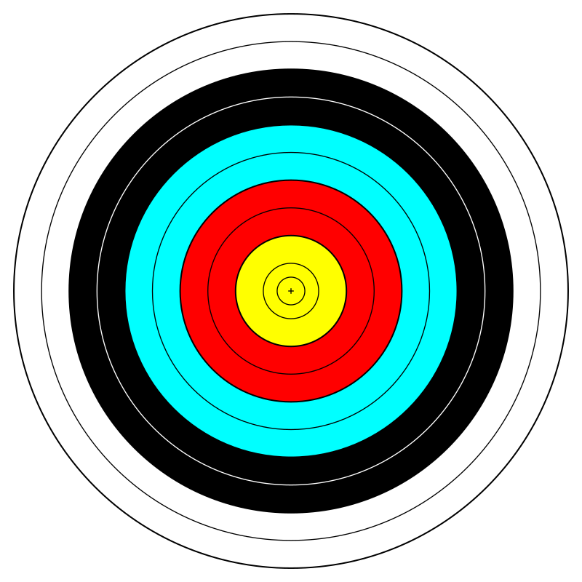
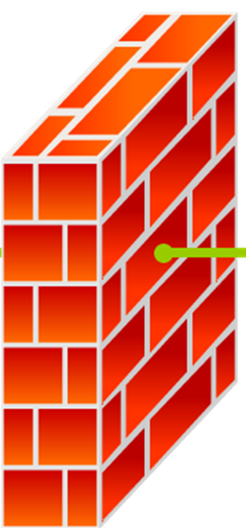

Defending Against App-Level DDoS
Internet
The server is the target
In an application-level DDoS, the attack targets a resource that the service depends on.
A firewall that can filter the attack traffic can protect the server, allowing clients continued access.

Slide 6
Against Network Volumetric DDoS
Internet
The network
is the target
In a bandwidth volumetric attack, the attackers over-use the network connection.
A firewall on its own cannot defend against such an attack—the attack’s impact is “outside” the firewall.

Slide 7

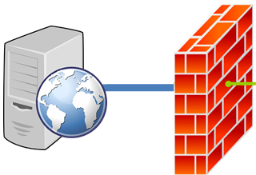
Integrated with an Overlay Network
P
P
P
P
P
Internet
An overlay network (e.g., Cloudflare®, Akamai©, etc.) has the bandwidth to absorb very large volumetric attacks.
But, if the edge servers forward the requests, they will DoS the origin server.
With a blacklist API, allows the NNBC firewall to identify which flows to block, ensuring that good clients get access to the server.

Slide 8
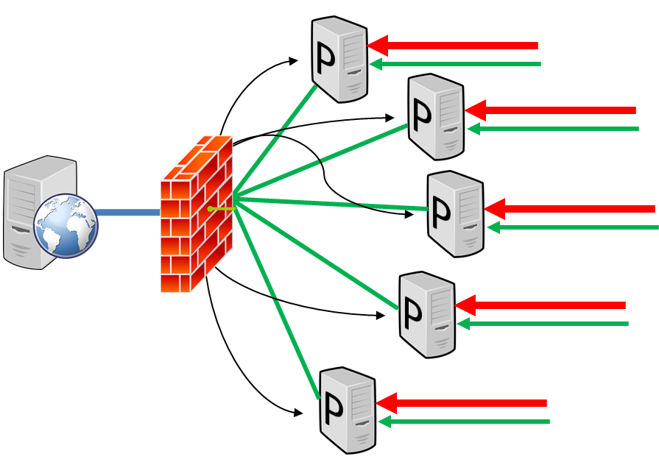
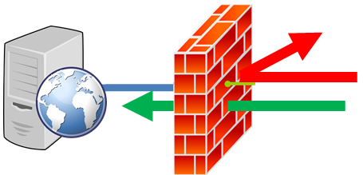
The NNBC in both Contexts
We will present results for the NNBC Firewall both defending against application-level attacks as a standalone system and working with an overlay provider to defend against bandwidth volumetric attacks.

Slide 9
The NNBC Base Concept
The NNBC responds to an observed attack.
  A “canary” client detects when the site is down or badly-performing.
  Temporal correlation identifies attacking hosts, which are blocked.
  Forgiveness quickly relieves false positives; allows the NNBC to react quickly and emphatically.

Slide 10
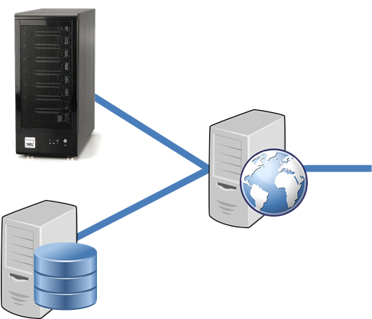

NNBC Comprises Two Activities
NNBC
!
i
f
a
Clients
Activity #1: Maintain partial ordering of clients
a
System health—moving average of canary client results.
i
c
f
Activity #2: Set threshold between attackers and non-attackers
If a canary access fails, the scores of the clients that accessed the server in that time period are decremented.
b
e
d

Slide 11
NNBC Comprises Two Activities
NNBC
Clients
Activity #1: Maintain partial ordering of clients
System health—moving average of canary client results.
c
Activity #2: Set threshold between attackers and non-attackers
If a canary access fails, the scores of the clients that accessed the server in that time period are decremented.
b
a
e
i
d
f

Slide 12
NNBC Comprises Two Activities
NNBC
Clients
Activity #1: Maintain partial ordering of clients
c
System health—moving average of canary client results.
b
a
Activity #2: Set threshold between attackers and non-attackers
e
i
d
f
The threshold is set by a PI Controller that tracks system health.

Slide 13
NNBC Comprises Two Activities
NNBC
Clients
Activity #1: Maintain partial ordering of clients
c
System health—moving average of canary client results.
b
a
Activity #2: Set threshold between attackers and non-attackers
e
i
d
f
The threshold is set by a PI Controller that tracks system health.

Slide 14
NNBC Behavior Under Attack
Non-attack period
  Client scores are drifting
  towards zero.
  The threshold is below
  all client scores.
The attack begins
  The threshold rises
  dramatically.
  Attackers’ scores drop
  more than good-
  client scores.
The attack continues
  The threshold oscillates, blocking-then-forgiving
  The attacker and non-attacker scores separate, eliminating the false-positive blocking that occurred in the first seconds of the attack.

Slide 15
NNBC Behavior Under Attack
Non-attack period
  Client scores are drifting
  towards zero.
  The threshold is below
  all client scores.
The attack begins
  The threshold rises
  dramatically.
  Attackers’ scores drop
  more than good-
  client scores.
The attack continues
  The threshold oscillates, blocking-then-forgiving
  The attacker and non-attacker scores separate, eliminating the false-positive blocking that occurred in the first seconds of the attack.

Slide 16
NNBC Behavior Under Attack
Non-attack period
  Client scores are drifting
  towards zero.
  The threshold is below
  all client scores.
The attack begins
  The threshold rises
  dramatically.
  Attackers’ scores drop
  more than good-
  client scores.
The attack continues
  The threshold oscillates, blocking-then-forgiving
  The attacker and non-attacker scores separate, eliminating the false-positive blocking that occurred in the first seconds of the attack.

Slide 17
NNBC Behavior Under Attack
Non-attack period
  Client scores are drifting
  towards zero.
  The threshold is below
  all client scores.
The attack begins
  The threshold rises
  dramatically.
  Attackers’ scores drop
  more than good-
  client scores.
The attack continues
  The threshold oscillates, blocking-then-forgiving
  The attacker and non-attacker scores separate, eliminating the false-positive blocking that occurred in the first seconds of the attack.

Slide 18
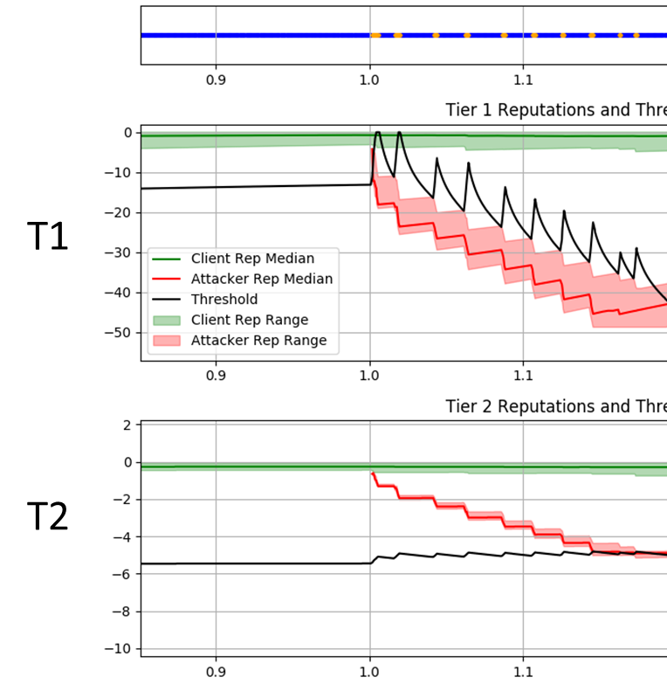
Addressing Persistent Infringement
A highly-reactive NNBC blocks
and forgives very quickly.
  This is a good thing—it quickly
  creates the separation.
  But it also gives attackers
  more chances to deny service.
Solution: introduce a second,
less-reactive NNBC.
  The client is block if either NNBC
  blocks it.
  The T2 NNBC only comes
  into play when the attacker
  persists.
    The T2 NNBC ‘s time-to-forgive
    increases with the # times a client has
    been forgiven.

Slide 19
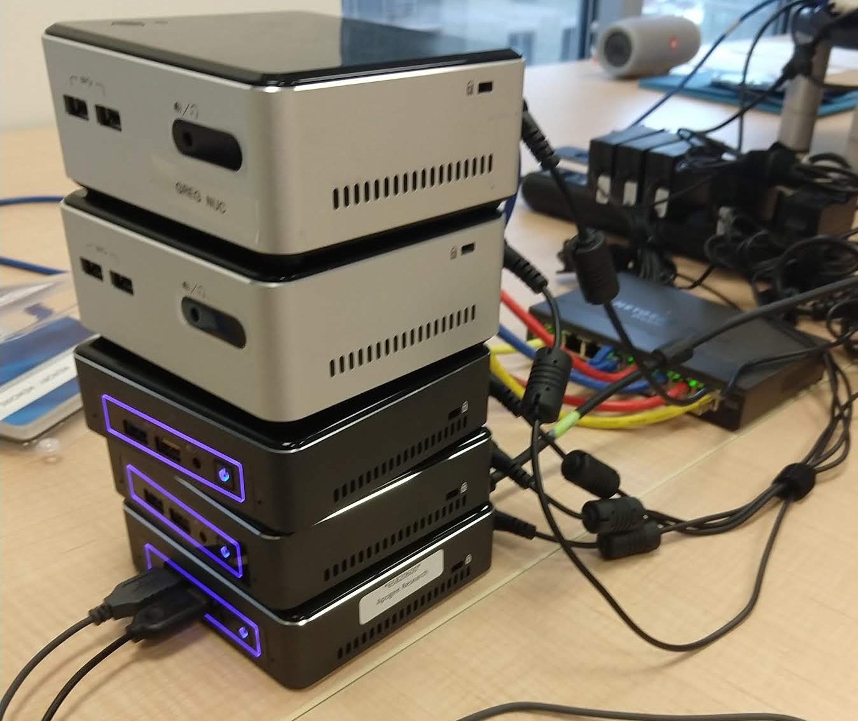
Five Experiments
Performance Baseline
  With no attacks, compare performance with and without the NNBC Firewall
Application-Level Volumetric Attack
  GET-flood, accessing large image.
Application-Level Algorithmic Attack
  A URL that crashes the server. A watchdog brings the server back up w/in 3 seconds.
Network Bandwidth Volumetric
  The firewall must cooperate with the overlay network to thwart the attack.
Benign Oversubscription
  For twelve minutes, the benign clients access the server at a higher rate than can be sustained.
    Show that the NNBC firewall does not penalize the clients—that the server performance is not degraded beyond the effect of the oversub-scription.
5 Intel NUCs
  3 run good and attack clients
    Many thousands of IP addresses
  1 runs the overlay network
  1 runs the web server and its NNBC firewall

Slide 20
1. Performance Baseline
 | Undefended | Defended
# Successful Requests | 37,579 | 37,706
# Failed Requests | 0 | 0
Demonstrate that the NNBC does no
harm under normal conditions.
  1 hour experiment.
  1000 clients, exponential distribution of
  accesses, λ=90 seconds.
  Requesting one of: a small static page;
  a large image; or dynamic content.
Over the entire experiment:
  The sensor had 3 false-positive alerts.
  But zero client accesses were blocked.
The sensor reports a problem if its request takes more than one second.
A client’s access is deemed a failure if it takes more than two seconds.

Slide 21
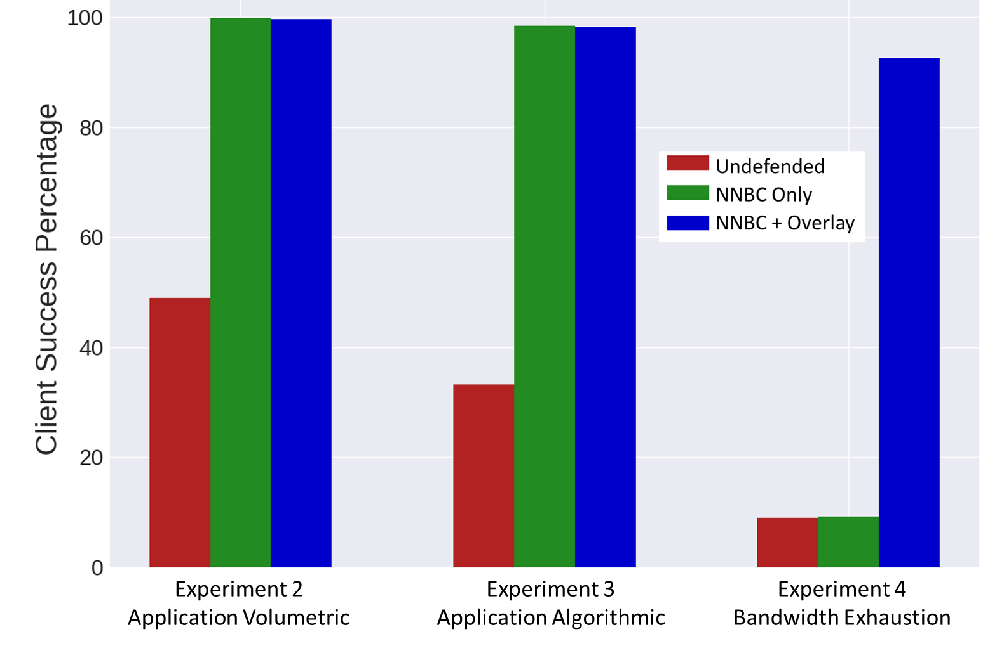
2, 3, 4: Attack Experiments

Slide 22
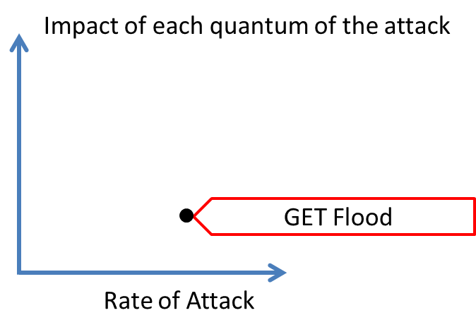
2, 3, 4: Attack Experiments
1,000 attackers, attacking once per second.
Accessing large image.

Slide 23
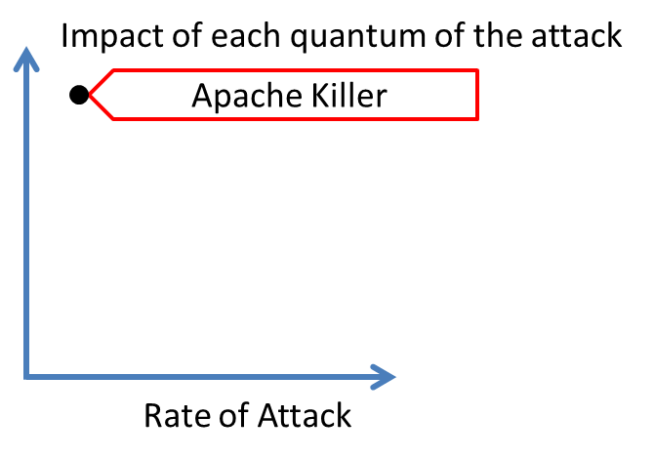
2, 3, 4: Attack Experiments
20 attackers, attacking once per 20 seconds.
Accessing URL that shuts the defended server down. Watchdog restarts the server after 3 seconds.
The ultimate algorithmic attack!

Slide 24
2, 3, 4: Attack Experiments
1,000 attackers making POST requests as fast as they can.
Each POST contains 4MB of content, exhausting the network bandwidth.
Updating the overlay network’s blacklist has a 10 min latency.
Impact of each quantum of the attack
Network Flood
Rate of Attack

Slide 25
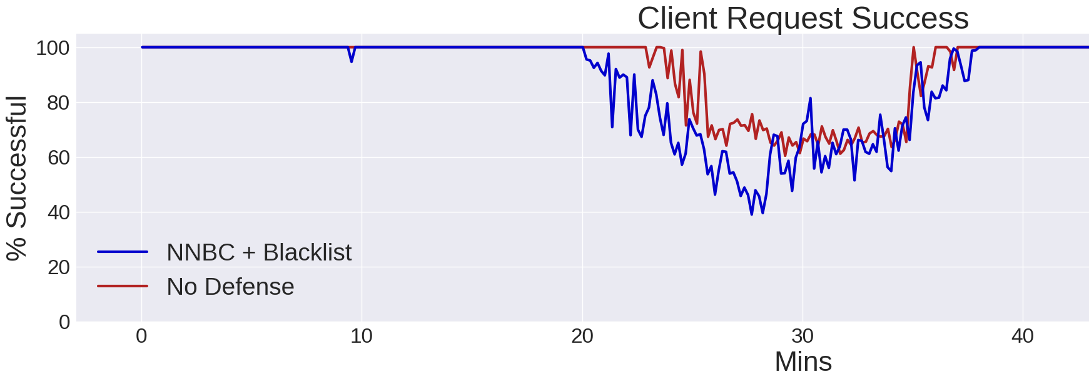
5. Benign Oversubscription
Run a one-hour experiment with no attackers.
  For the first 20 minutes, the client load is ~1/3 of the server’s capacity.
  The client load triples over the next 5 min.
  At 31:40, the client load reduces back to 1/3 server capacity.
  A client request is deemed to have failed if it takes more than 2 seconds to resolve.
The NNBC-defended server has marginally worse performance.
  The sensor detects DoS when its request takes more than 1 second.
But when the burst of activity ends, the performance of both systems returns to 100%.
  The NNBC does not create a lasting negative impact.

Slide 26
Final Bullets
The NNBC Firewall detects and blocks zero-day, non-volumetric DDoS attacks.
  No deep-packet inspection, it operates purely based on the impact that client requests have on server performance.
  It also mitigates volumetric app-level attacks, and when integrated with a a WAF-equipped overlay network mitigates volumetric network-level attacks.
We’ve presented hands-off results.
  One can administer this system. It has a nice visualization, and given that scores are kept in a postgres db, one can easily write scripts to cleanse individual clients or the whole db.
The system works without long-term memory.
  It does not cripple the system to simply wipe the db.
The code has been submitted for public release.
  Will be available under the BSD 3-clause open source license.

